Slide 1
Lead Score Case Study

Slide 2
Problem statement
An education company named X Education sells online courses to industry professionals. On any given day, many professionals who are interested in the courses land on their website and browse for courses
The company markets its courses on several websites and search engines like Google. Once these people land on the website, they might browse the courses or fill up a form for the course or watch some videos. When these people fill up a form providing their email address or phone number, they are classified to be a lead. Now, although X Education gets a lot of leads, its lead conversion rate is very poor. For example, if, say, they acquire 100 leads in a day, only about 30 of them are converted. To make this process more efficient, the company wishes to identify the most potential leads, also known as ‘Hot Leads’.
The company requires you to build a model wherein you need to assign a lead score to each of the leads such that the customers with a higher lead score have a higher conversion chance and the customers with a lower lead score have a lower conversion chance.

Slide 3
Business Objective
The company wants to increase their conversion rate from 30% to 80%
They want a model which can give hot leads i.e. with high conversion rate
They want an efficient process to reduce the time spent on lower conversion leads

Slide 4
Data
Lead Origin
Lead Source
Do Not Email
Do Not Call
Converted
TotalVisits
Total Time Spent on Website
Page Views Per Visit
The given data contains different information about each lead in 37 columns.
‘Converted’ is the target variable which gives information if the lead gets converted or not.
The target variable is balanced with 60% of 0’s and 40% of 1’s

Slide 5
EDA steps taken
Missing value treatment
- There were some columns with around 30% of missing values. Decided the drop these columns.
- Select value in some columns can also be considered under missing values.
- Imputed the missing values of numeric columns with mean value and categorical columns with mode value
Zero variance columns
- Some columns like have only one value. This is not of any use while prediction. Hence dropping these columns.

Slide 6
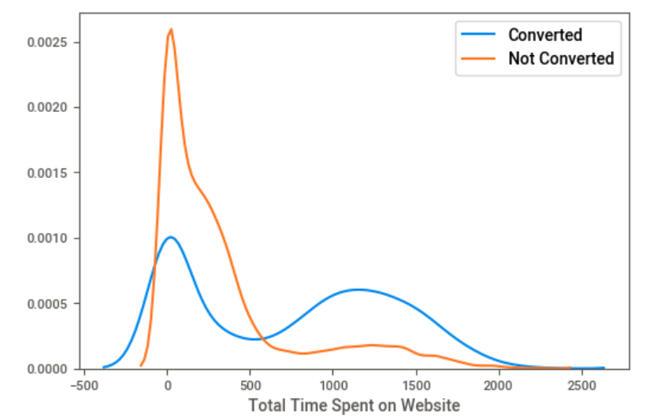
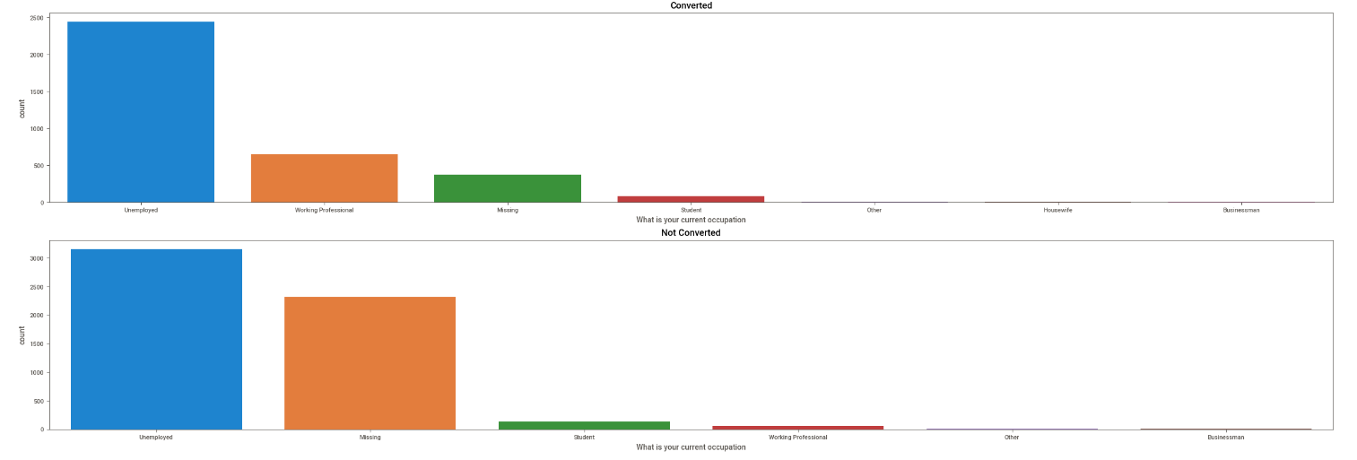
Data Visualizations
Surprisingly, people who spent more time on the website are turning out to be not converted. People who spend moderate time on the website are turning out to be converted.
We can clearly see Working professionals have the high probability of getting converted after unemployed

Slide 7
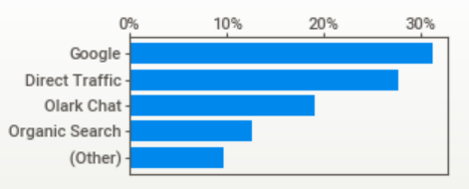
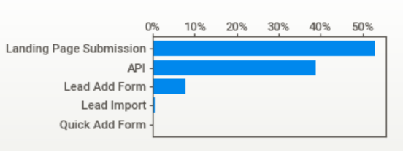
Data Visualizations
Lead Origin has more than 50% values as ‘Landing page submission’ and ‘API’ around 40%
Lead source has values such as Google, Direct Traffic, Olark chat

Slide 8
Data Preparation
Dummy Value Creation
- Created dummy values for all the categorical columns using get_dummies
Data scaling
- Using MinMaxScaler scaled all the numerical features so that all the values are on the same scale for comparison and prediction.
Correlation Check
- Check for correlation among the columns. We will eliminate the correlated columns after checking the VIF score

Slide 9
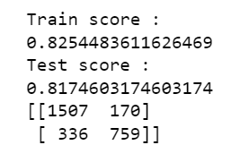
Data Modelling
Using Logistic regression to find the initial performance of the model. The performance looks good with 82% accuracy in train set and 81% in test set.
Confusion matrix also looks good with fewer false Negatives (336) i.e., Leads that are predicted not converted when they are Converted.
Using RFE to select 15 important features.
Using GLM model to calculate p value and eliminate the variables with p value >0.05
VIF score looks good and below the threshold 5 for all the variables

Slide 10
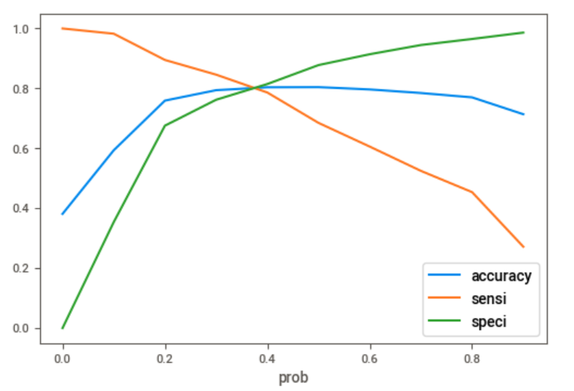
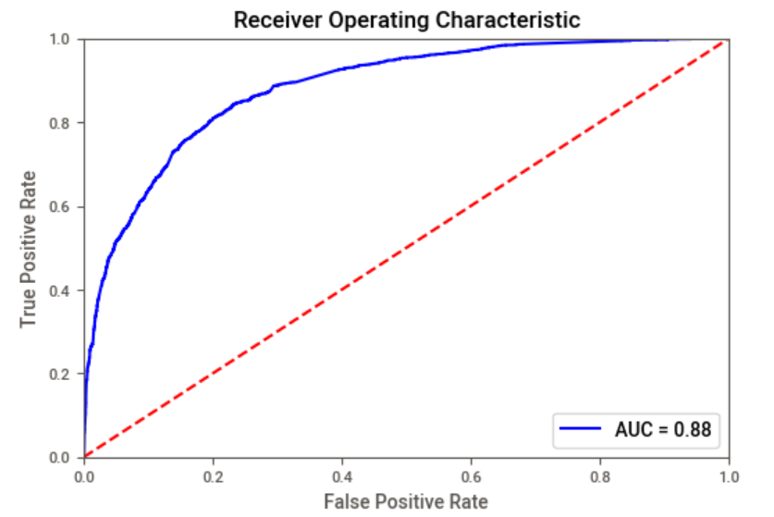
Optimal cut-off value
After the p value and VIF score looks good, Make a predictions again and get the model metrics
Choose the initial cut off as 0.5, Obtained an AUC of 0.88 with this cut off
Find the optimal cut off by checking the trade off graph between accuracy, sensitivity and specificity
Obtained the cut off value of 0.38
Made final predictions in train set with this cut off

Slide 11
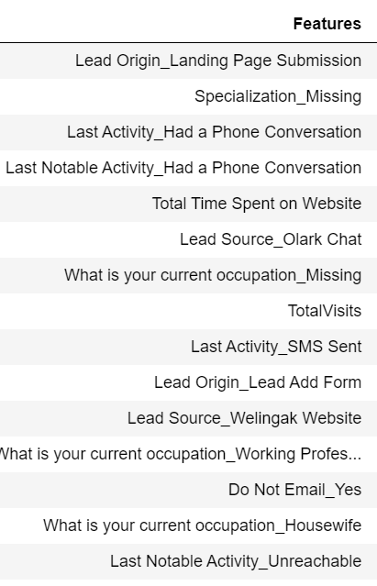

Predictions on test data
Make predictions on the test data using the same model
Given are the top 15 features list

Slide 12
Conclusions
Working professionals are more likely to convert after unemployed.
Most of the traffic is coming from Google and direct traffic.
The conversion rate for Landing page submission and API are less. Business needs to focus these areas.

